Slide 1
Project 3:
Comparing Q&A Subreddits
Which questions get answered and how?
Notes:
Spoiler: most of them
And I still don’t know

Slide 2
Table of contents
01
02
03
Which Subreddits?
Process & Results
So What?
And why
Coding & modelling
Zooming way out
Notes:
There’s a lot of them
Most of us did similar things, in general
Nothing too shocking here
Bigger Scope project & actually interesting!

Slide 3
01
Which Subreddits?
People have a lot of questions
Notes:
I like trivia
I used to own reference books
Post-it lists

Slide 4
Lots of questions, lots of forums
Ask Reddit
No Stupid Questions
Explain like I’m five
Answers
Out of the Loop
Notes:
I like learning facts
and follow at least one general Q&A forum
Curious about the differences between them
different questions in different subs?
different answers and/or depth of answers?

Slide 5
How these subreddits work
Questions
Answers
Solution?
Rules!
Also rules!
Or discussion
Notes:
Yes, eli5 is much stricter in every way
And more formal
Questions
Answer
Both = formality & content
implications for data processing = more parsing
But possibly easier

Slide 6
02
Process & Modelling

Slide 7
API & NLP
Reddit API
Pre-processing
Easy, repeated
Easy, iterative
Data Modelling
Interpretation
Grayer-box, Iterative
Trickier
Notes:
Grabbing data, over several days per Tim’s advice
cleaned : removed anything without post text
Did not: remove or care about links
Pandas & Count vectorizer, which includes tokenizing & n-gram parsing
—skimming this—
4 - What caused these results? What do these results imply?
Imply for future use of model
Imply in the real world

Slide 8
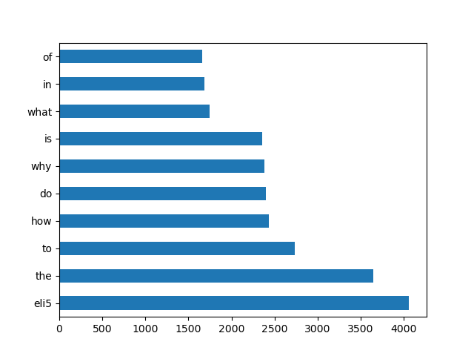
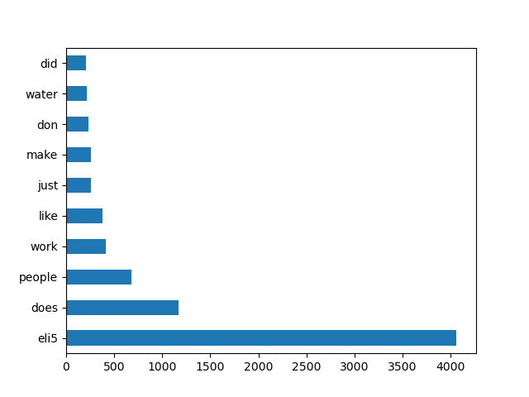
Words shared in both corpora?
Notes:
Left image might look familiar to the rest of you
Right image has an obvious outlier due to rules (and data-cleaning incompleteness)

Slide 9
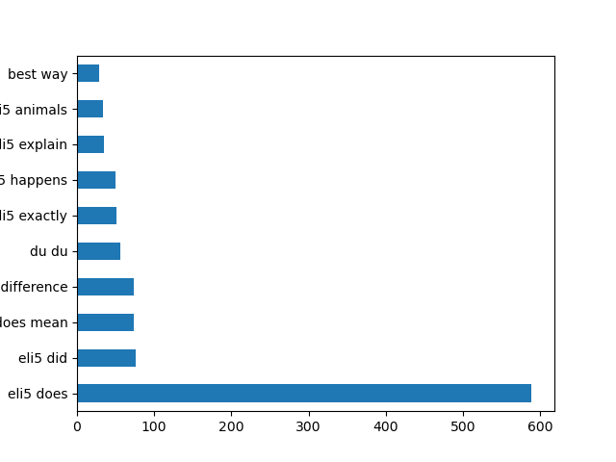
Bigrams are better,
but not by much
Notes:
mostly stop words due to domain context (question words: does, explain)
Eli5 still dominates
What does du du mean?

Slide 10
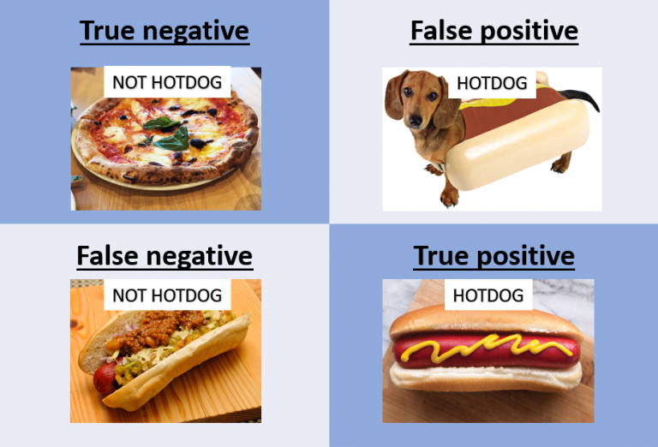
Accuracy?

Slide 11
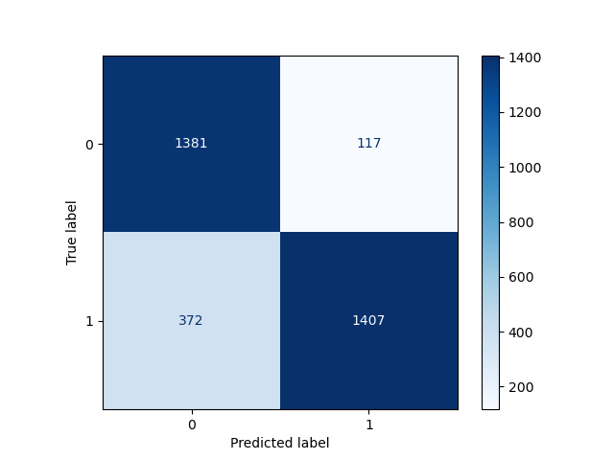
My model needs improvement
Notes:
Way too many food hot-dogs are going to waste here!
False Negatives are the main “wrong” answer.

Slide 12
03
Conclusions & Suggestions

Slide 13

One or more of these people may visit Reddit

Slide 14
No really, so what?
AI
UX pathways
Any ideas?
Notes:
Which q’s can AI handle just as well, without human intervention?
Definitely don’t know from this project
my model next steps = more data cleaning
Can similar parsing lead the askers to the right answer?
My AI/librarians referencegroup says “that’s an eli5” question
Tailoring answer style and scope accordingly

Slide 15
Thanks!
Classmates in the Project 3 breakout room.
GA’s lesson planners & our teachers.
Various websites with various attributions in my code.
Please keep this slide for attribution

Slide 16
Any questions?

